Slide 1
EVS ASSIGNMENT
NAME: Lance Lionel Barreto
SECTION H
ROLL NUMBER 81
REGISTRATION NUMBER: 210953276

Slide 2
ACTIVITY 1
AIM: TO DESCRIBE THE ENVIRONMENTAL PROBLEMS OF YOUR LOCALITY AND SUGGEST A REMEDY.

Slide 3
Foreword
Environmental concerns have risen dramatically in recent years.
In our daily lives, these changes appear insignificant. However, they develop into major issues over time.
This could be due to our lack of understanding of the consequences of our actions.

Slide 4
OBSERVATIONS-I
List of environmental issues in my locality:
Water pollution
Deforestation
Landslides

Slide 5
LANDSLIDES
Development has a vital part in the world today.
However carrying it out without proper planning and forethought is dangerous and can pose a threat to the people the original development was meant to benefit.
Wide scale landscaping can cause the soil in the area to lose its stability and this leads to landslides.
This along with the heavy rainfall in Goa leads to landslides almost every year.

Slide 6
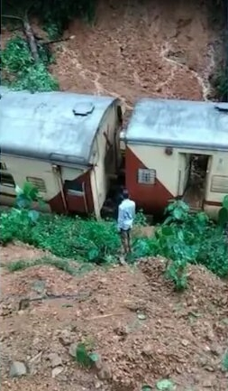
Due to a landslide caused by heavy rains, a passenger train from Mangaluru Junction to Chhatrapati Shivaji Maharaj Terminus derailed between Dudhsagar and Sonaulim in South Goa on Friday. The South Western Railway said in a statement that no injuries or deaths were reported as a result of the incident.

Slide 7
DEFORESTATION
Goa has a substantial forest cover with a diverse range of plants.
In the state of Goa, deforestation is a major issue.
For the sake of mining and development, large swaths of forest land are cleared.
This problem is caused not only by contemporary projects, but also by historical agricultural methods such as Swash-and-Burn.

Slide 8
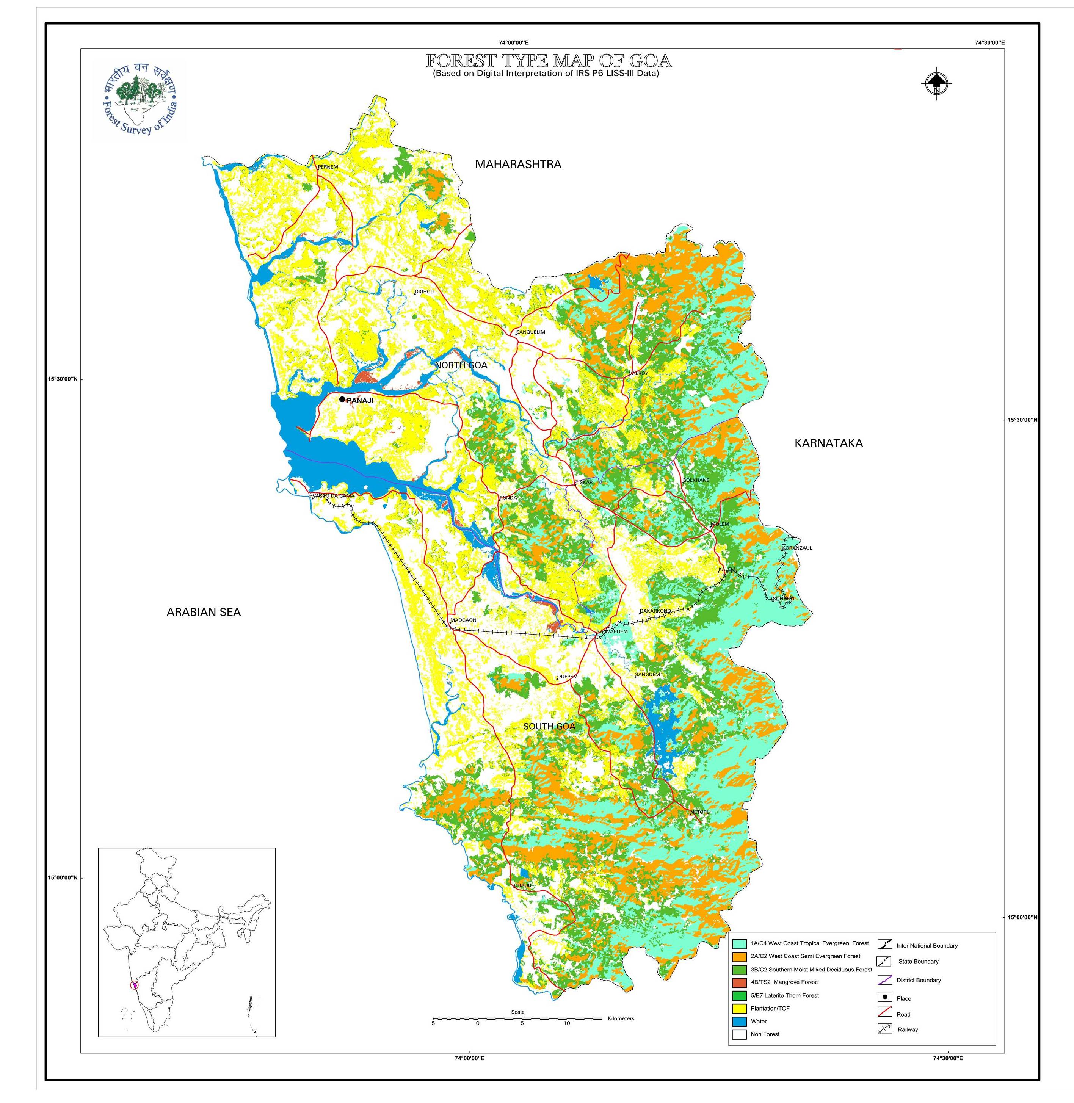
Types of Forests in Goa
Estuarine vegetation consisting mainly of mangroves
Strand vegetation alone the coastal belts
Plateau vegetation
Semi-evergreen and evergreen forests

Slide 9
WATER POLLUTION
Water pollution occurs when chemicals contaminate water sources, rendering the water unfit for drinking, cooking, cleaning, swimming, and other activities.
Water pollution can come from both direct and indirect sources.
Effluent outfalls from factories and refineries, for example, are direct sources.
Contaminants that reach the water supply through soils or groundwater systems, as well as rain, are examples of indirect sources of water contamination.

Slide 10
OBSERVATIONS-II
Primary environmental issue, its cause and suggested remedies for the identified problems:
In Goa landslides and deforestation are the biggest issues.
Caused by development and the mining industry.
Mining should continue to be banned in the state and it should focus on further developing as a tourist hub sustainably.
Deforestation can be combatted with afforestation

Slide 11
ACTIVITY 2
AIM: TO DESCRIBE: A) CLIMATE OF YOUR AREA. B) YEARLY VARIATION IN SUSPENDED PARTICULATE MATTER IN THE SAME AREA.

Slide 12
OBSERVATIONS
MONTH | MAX TEMP(°C) | MIN TEMP(°C) | RAINFALL (inches) | HUMIDITY | RELATIVE HUMIDITY | RSPM (ppm)
January | 30 | 18 | 0 | 0.011 | 59% | 149
February | 31 | 17 | 0 | 0.014 | 62% | 81
March | 36 | 20 | 0.3 | 0.019 | 70% | 75
April | 36 | 22 | 0.4 | 0.020 | 72% | 49
May | 31 | 22 | 3.2 | 0.020 | 74% | 65
June | 29 | 21 | 28.7 | 0.023 | 89% | 32
July | 29 | 21 | 41.7 | 0.022 | 92% | 21
August | 29 | 21 | 28.1 | 0.022 | 91% | 19
September | 29 | 21 | 12.3 | 0.022 | 89% | 37
October | 31 | 20 | 6.7 | 0.021 | 83% | 54
November | 30 | 19 | 1.4 | 0.018 | 89% | 68
December | 29 | 18 | 0.2 | 0.011 | 58% | 124

Slide 13
Maximum Temperature

Slide 14
Minimum Temperature

Slide 15
Rainfall

Slide 16
Humidity

Slide 17
Relative Humidity

Slide 18
RSPM

Slide 19
DISCUSSION
Which month of the year shows the highest average maximum temperature and why?
March and April show the highest average maximum temperature. This is the start and middle of summer and the Sun’s rays hit the earth nearly vertically and are thus not spread out much, increasing the amount of energy incident at any area.
Which month of the year shows the lowest average minimum temperature and why?
February shows lowest average minimum temperature. This is the end of winter and the Sun’s rays hit the ground at a relatively smaller angle and thus are spread out over a larger area.

Slide 20
Which month of the year shows the highest average rainfall and why?
July shows highest average rainfall. July is the peak of the monsoon season.
Which month of the year shows the lowest average rainfall and why?
January and February.
Which month of the year shows the highest average humidity and why?
June shows the highest average humidity. This is because humidity is highest during the monsoon season.
Which month of the year shows the lowest average humidity and why?
January shows lowest average humidity.
Which month of the year shows the highest average relative humidity and why?
July shows highest average humidity.

Slide 21
Which month of year shows the lowest average relative humidity and why?
December shows lowest average relative humidity.
Which month of the year shows the highest average RSPM?
January shows highest average RSPM value.

Slide 22
ACTIVITY 3
AIM: TO MAKE AN AUDIT OF THE ELECTRICAL ENERGY CONSUMPTION BY VARIOUS HOUSEHOLD APPLIANCES AT YOUR HOME.

Slide 23
S. No. | Electrical Appliance | Power of Appliance | Duration Used | Energy Consumed
1. | Refrigerator | 250 | 24 | 6000
2. | Microwave | 1000 | 0.25 | 250
3. | Air fryer | 1400 | 0.5 | 700
4. | Kettle | 1400 | 0.25 | 350
5. | Water filter | 60 | 24 | 1440
6. | Iron | 1000 | 1.5 | 1500
7. | Router | 15 | 24 | 360
8. | TV 1 | 50 | 3 | 150
9. | TV 2 | 50 | 2 | 100
10. | AC 1 | 1000 | 9 | 9000
11. | AC 2 | 1000 | 9 | 9000
12. | AC 3 | 1000 | 12 | 1200
13. | Geyser | 500 | 1.5 | 750
14. | Printer | 40 | 0.5 | 20

Slide 24
S. No. | Electrical Appliance | Power of Appliance | Duration Used | Energy Consumed
15. | Bulb 1 | 60 | 4 | 240
16. | Bulb 2 | 60 | 4 | 240
17. | Bulb 3 | 60 | 3 | 180
18. | Tube light 1 | 18 | 8 | 144
19. | Tube light 2 | 18 | 8 | 144
20. | Tube light 3 | 18 | 12 | 216
21. | Tube light 4 | 18 | 12 | 216
22. | Fan 1 | 75 | 4 | 300
23. | Fan 2 | 75 | 14 | 1050
24. | Bulb 4 | 60 | 0.25 | 15
25. | Bulb 5 | 60 | 3 | 180
26. | Bulb 6 | 60 | 3 | 180
27. | Bulb 7 | 60 | 1 | 60
28. | Bulb 8 | 60 | 1 | 60

Slide 25
S. No. | Electrical Appliance | Power of Appliance | Duration Used | Energy Consumed
29. | Bulb 9 | 60 | 9 | 540
30. | Bulb 10 | 60 | 9 | 540
31. | Bulb 11 | 60 | 10 | 600
32. | Fan 3 | 75 | 18 | 1350
33. | Washing Machine | 2000 | 5 | 10000
34. | Dryer | 1800 | 5 | 9000
35. | Charger 1 | 6 | 2.5 | 15
36. | Charger 2 | 6 | 2 | 12
37. | Charger 3 | 6 | 1 | 6
38. | Charger 4 | 6 | 1.5 | 9
39. | Charger 5 | 6 | 3 | 18
40. | Laptop charger | 130 | 15 | 1950

Slide 26
Result:
Total Energy consumed in the day: 58.085.

Slide 28
ACTIVITY 4
AIM: TO OBSERVE THE WATER CRISIS ISSUES AND RECOMMENDING CONVERSATION STRATERGIES FOR THE GIVEN LOCATION

Slide 29
Table
S. No. | Type of Crisis | Reason for Crisis | Preventive measures
1. | Water pollution | Dumping of household waste, open defecation | Better waste collection, closed gutters, better sewage systems
2. | Water wastage | Breaking underground pipes | Planned water management system and implementation of manholes

Slide 30
Discussions
Where do you find any water wastage that could be avoided?
Leaving taps running while not in use, overfilling tanks.
What are the techniques that could be implemented to conserve water?
Rainwater harvesting
What are the measures to be taken to mitigate the water crisis issues under observation?
Better waste collection, closed gutters, better sewage systems, planned water management system and implementation of manholes

Slide 31
THANK YOU

